Slide 1

Capstone Project Presentation: Student Academic Performance & Risk Analytics

Slide 2

🎓 Student Academic Performance & Risk Analytics
Capstone Project – Introduction to Big Data Analytics
NIBISHAKA THOTI PACIFIQUE
Faculty of Information Technology, AUCA
Lecturer: Eric Maniraguha
4 August 2025

Slide 3



Project Overview
Objective
Tools Used
Analyze student performance data to identify at-risk students and provide actionable recommendations for intervention.
Python (Jupyter)
Power BI
UCI Dataset
This project leverages big data analytics to create a proactive system for student support, enhancing academic success and retention.

Slide 4
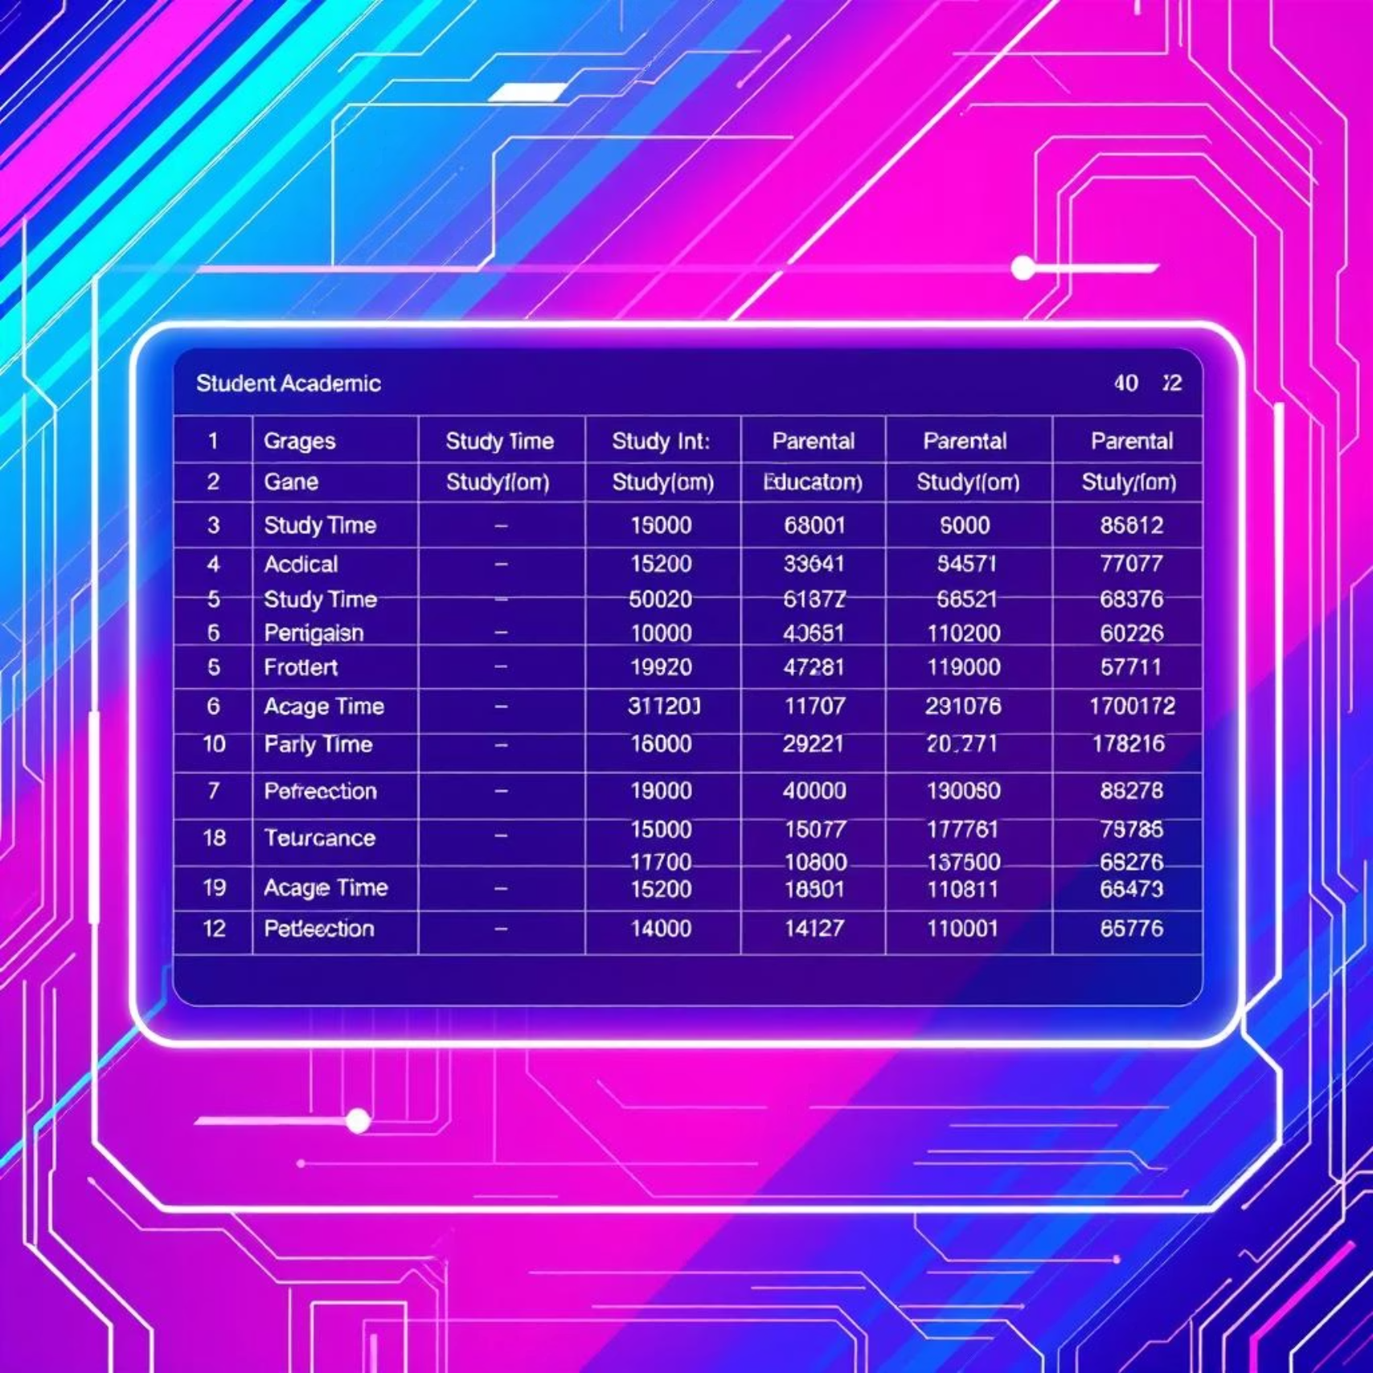
Data Sources & Preparation
Data Sources
UCI Student Performance Dataset (Math & Portuguese)
Contains demographic, social, and academic information for 649 students.
Preparation Steps
Removed missing values & duplicates 🧹
Encoded categorical variables (e.g., 'M'/'F' to 0/1) 🏷️
Feature engineering (e.g., calculated 'total study time' and 'parent education level' from raw fields) 🛠️
Rigorous data cleaning and feature engineering were essential for building robust predictive models.

Slide 5
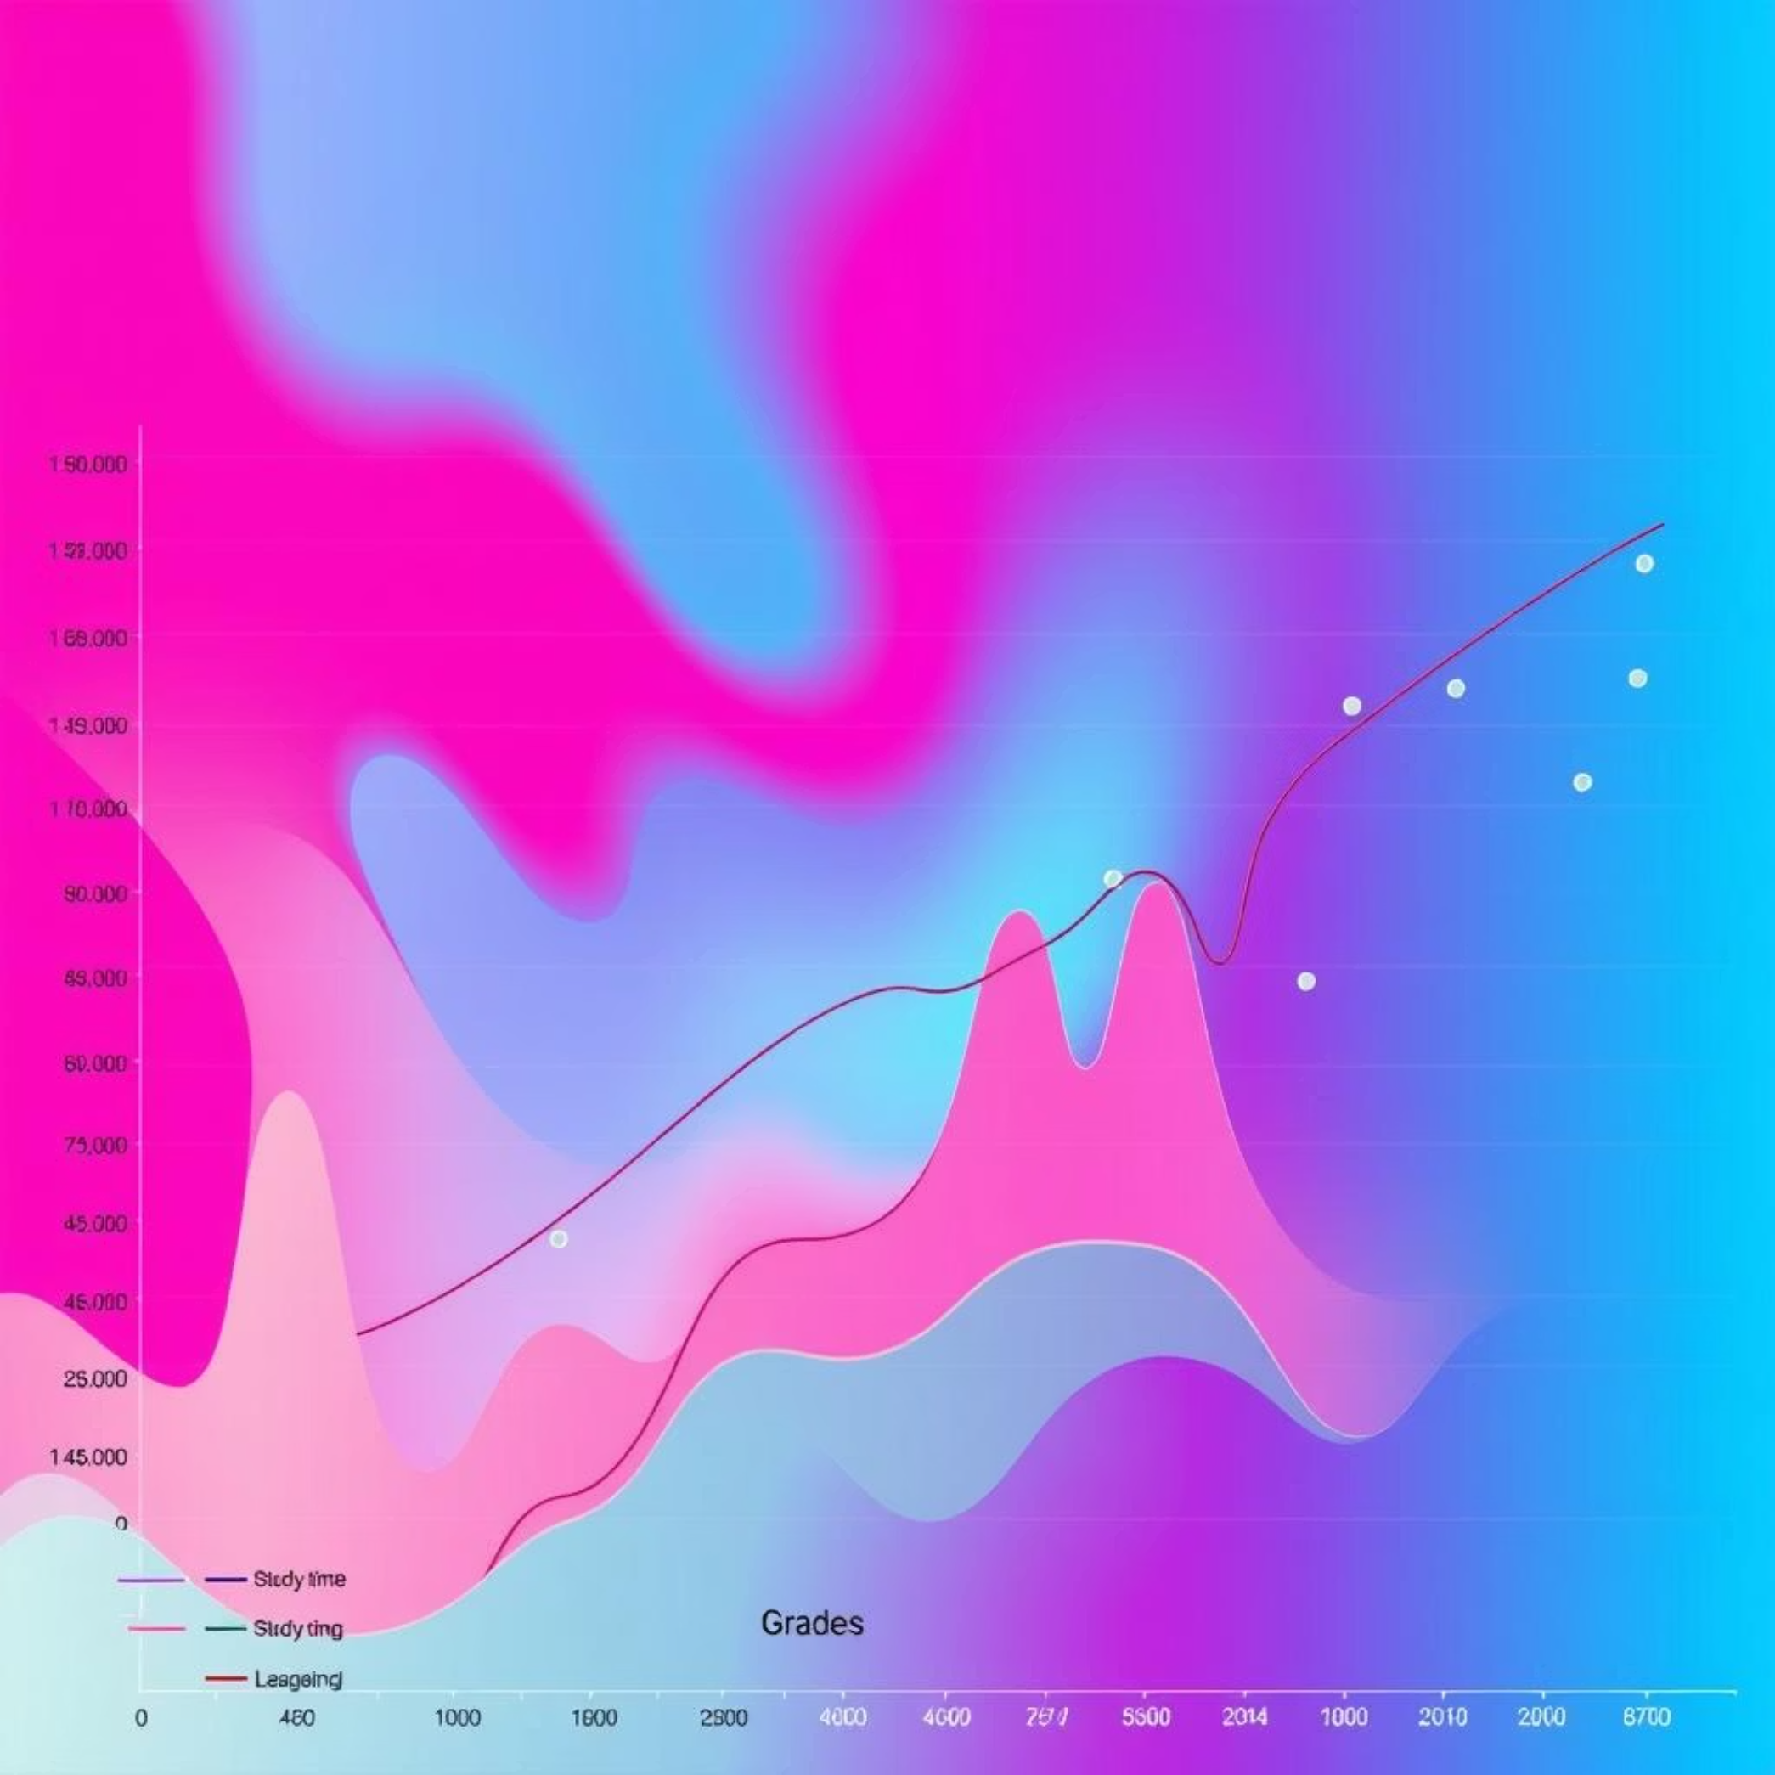
Exploratory Data Analysis
Descriptive Statistics
Calculated mean, median, mode, standard deviation, quartiles, and performed outlier detection to understand data distribution.
Key Visuals
Grade distributions revealed bimodal patterns in some subjects.
Correlation heatmaps highlighted strong relationships between prior academic performance and final grades.
Boxplots illustrated the spread of grades across various demographic groups.

Slide 6
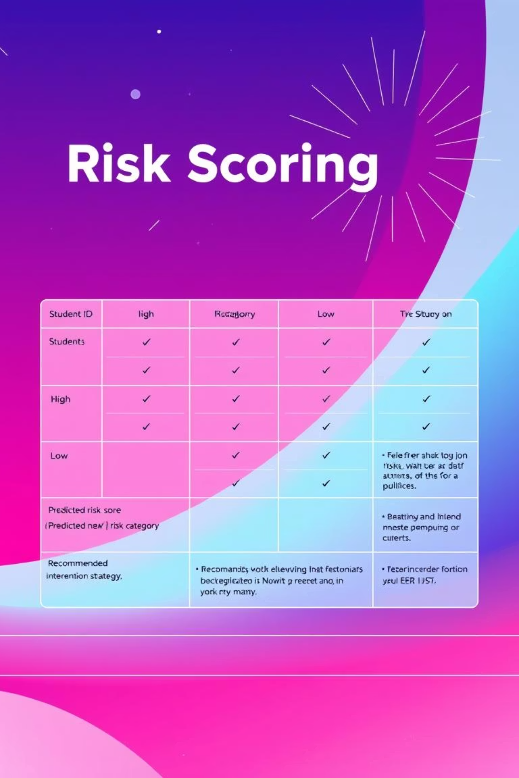
Modeling & Risk Analysis
Models Used
Risk Scoring
Random Forest and XGBoost models were trained for their predictive power and ability to handle complex feature interactions. An Ensemble model was also developed for improved accuracy.
A multi-factor risk scoring system was developed, combining academic, behavioral (e.g., absences), social, and environmental factors into a single score.
Outputs
The models generated precise risk scores, categorized students into low/medium/high risk tiers, and provided data-driven intervention recommendations.

Slide 7
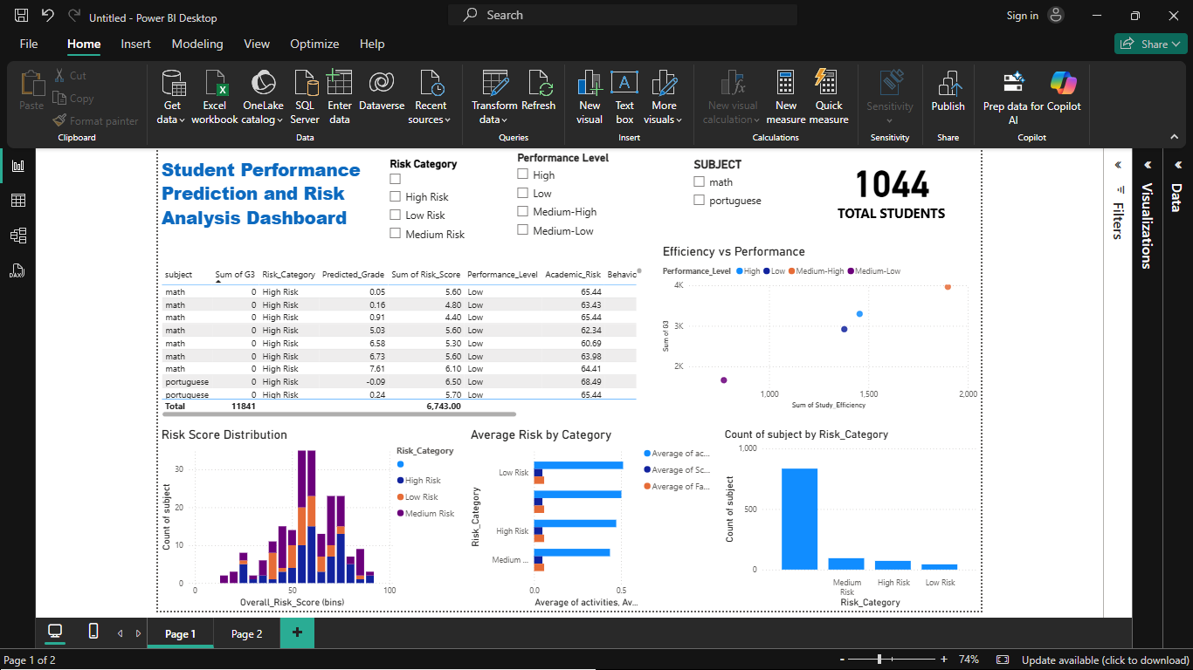
Power BI Dashboard
Data Imported
powerbi_export.csv
detailed_risk_analysis.csv
intervention_recommendations.csv
Key Visuals & Interactivity
Risk distribution by grade and demographic.
Table of high-risk students for quick identification.
Performance trends by study time.
Risk component analysis (academic, behavioral, social).
Interactive slicers, cards, tooltips, and bookmarks for dynamic analysis.

Slide 8




Key Insights
Academic Predictors
Behavioral Indicators
Previous grades and consistent study time are the strongest predictors of future academic performance. 📚
High absences and past course failures are highly correlated with increased risk of academic struggle. 🚨
Support Factors
Intervention Timing
Parental education level and family support significantly impact student outcomes. 👨‍👩‍👧‍👦
Early intervention is crucial for high-risk students to prevent further academic decline. 🏥

Slide 9
Recommendations
For Educators
For Students
For Administration
Implement early warning systems.
Maintain regular attendance.
Routinely monitor risk indicators.
Develop consistent study habits.
Allocate resources for targeted interventions.
Emphasize importance of study time and attendance.
Actively seek academic and personal support.
Track effectiveness of implemented support programs.
Enhance family engagement strategies.

Slide 10
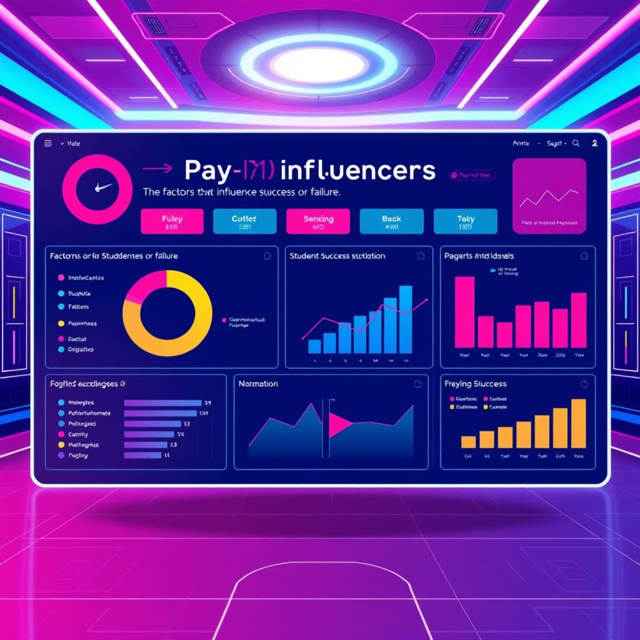
Innovation & Advanced Features
Multi-Factor Risk Assessment
Comprehensive analysis beyond just grades, integrating behavioral and social data.
Priority-Based Intervention System
Recommends specific interventions based on individual student risk profiles.
Interactive Power BI Dashboard
Utilizes advanced visuals and DAX for dynamic data exploration and decision-making.
These innovations provide a holistic view and proactive approach to student academic success.

